Slide 1






REZES
Recycling IoT Application Systems
E
N
E
WA
B
L
E
N
E
R
G
Y
ERO
N
E
R
G
Y
Q
U
A
N
D
E
R
I
N
G
408 Innovative System Design and Development II - Presentation
11 June 2019
Çankaya University

Slide 2
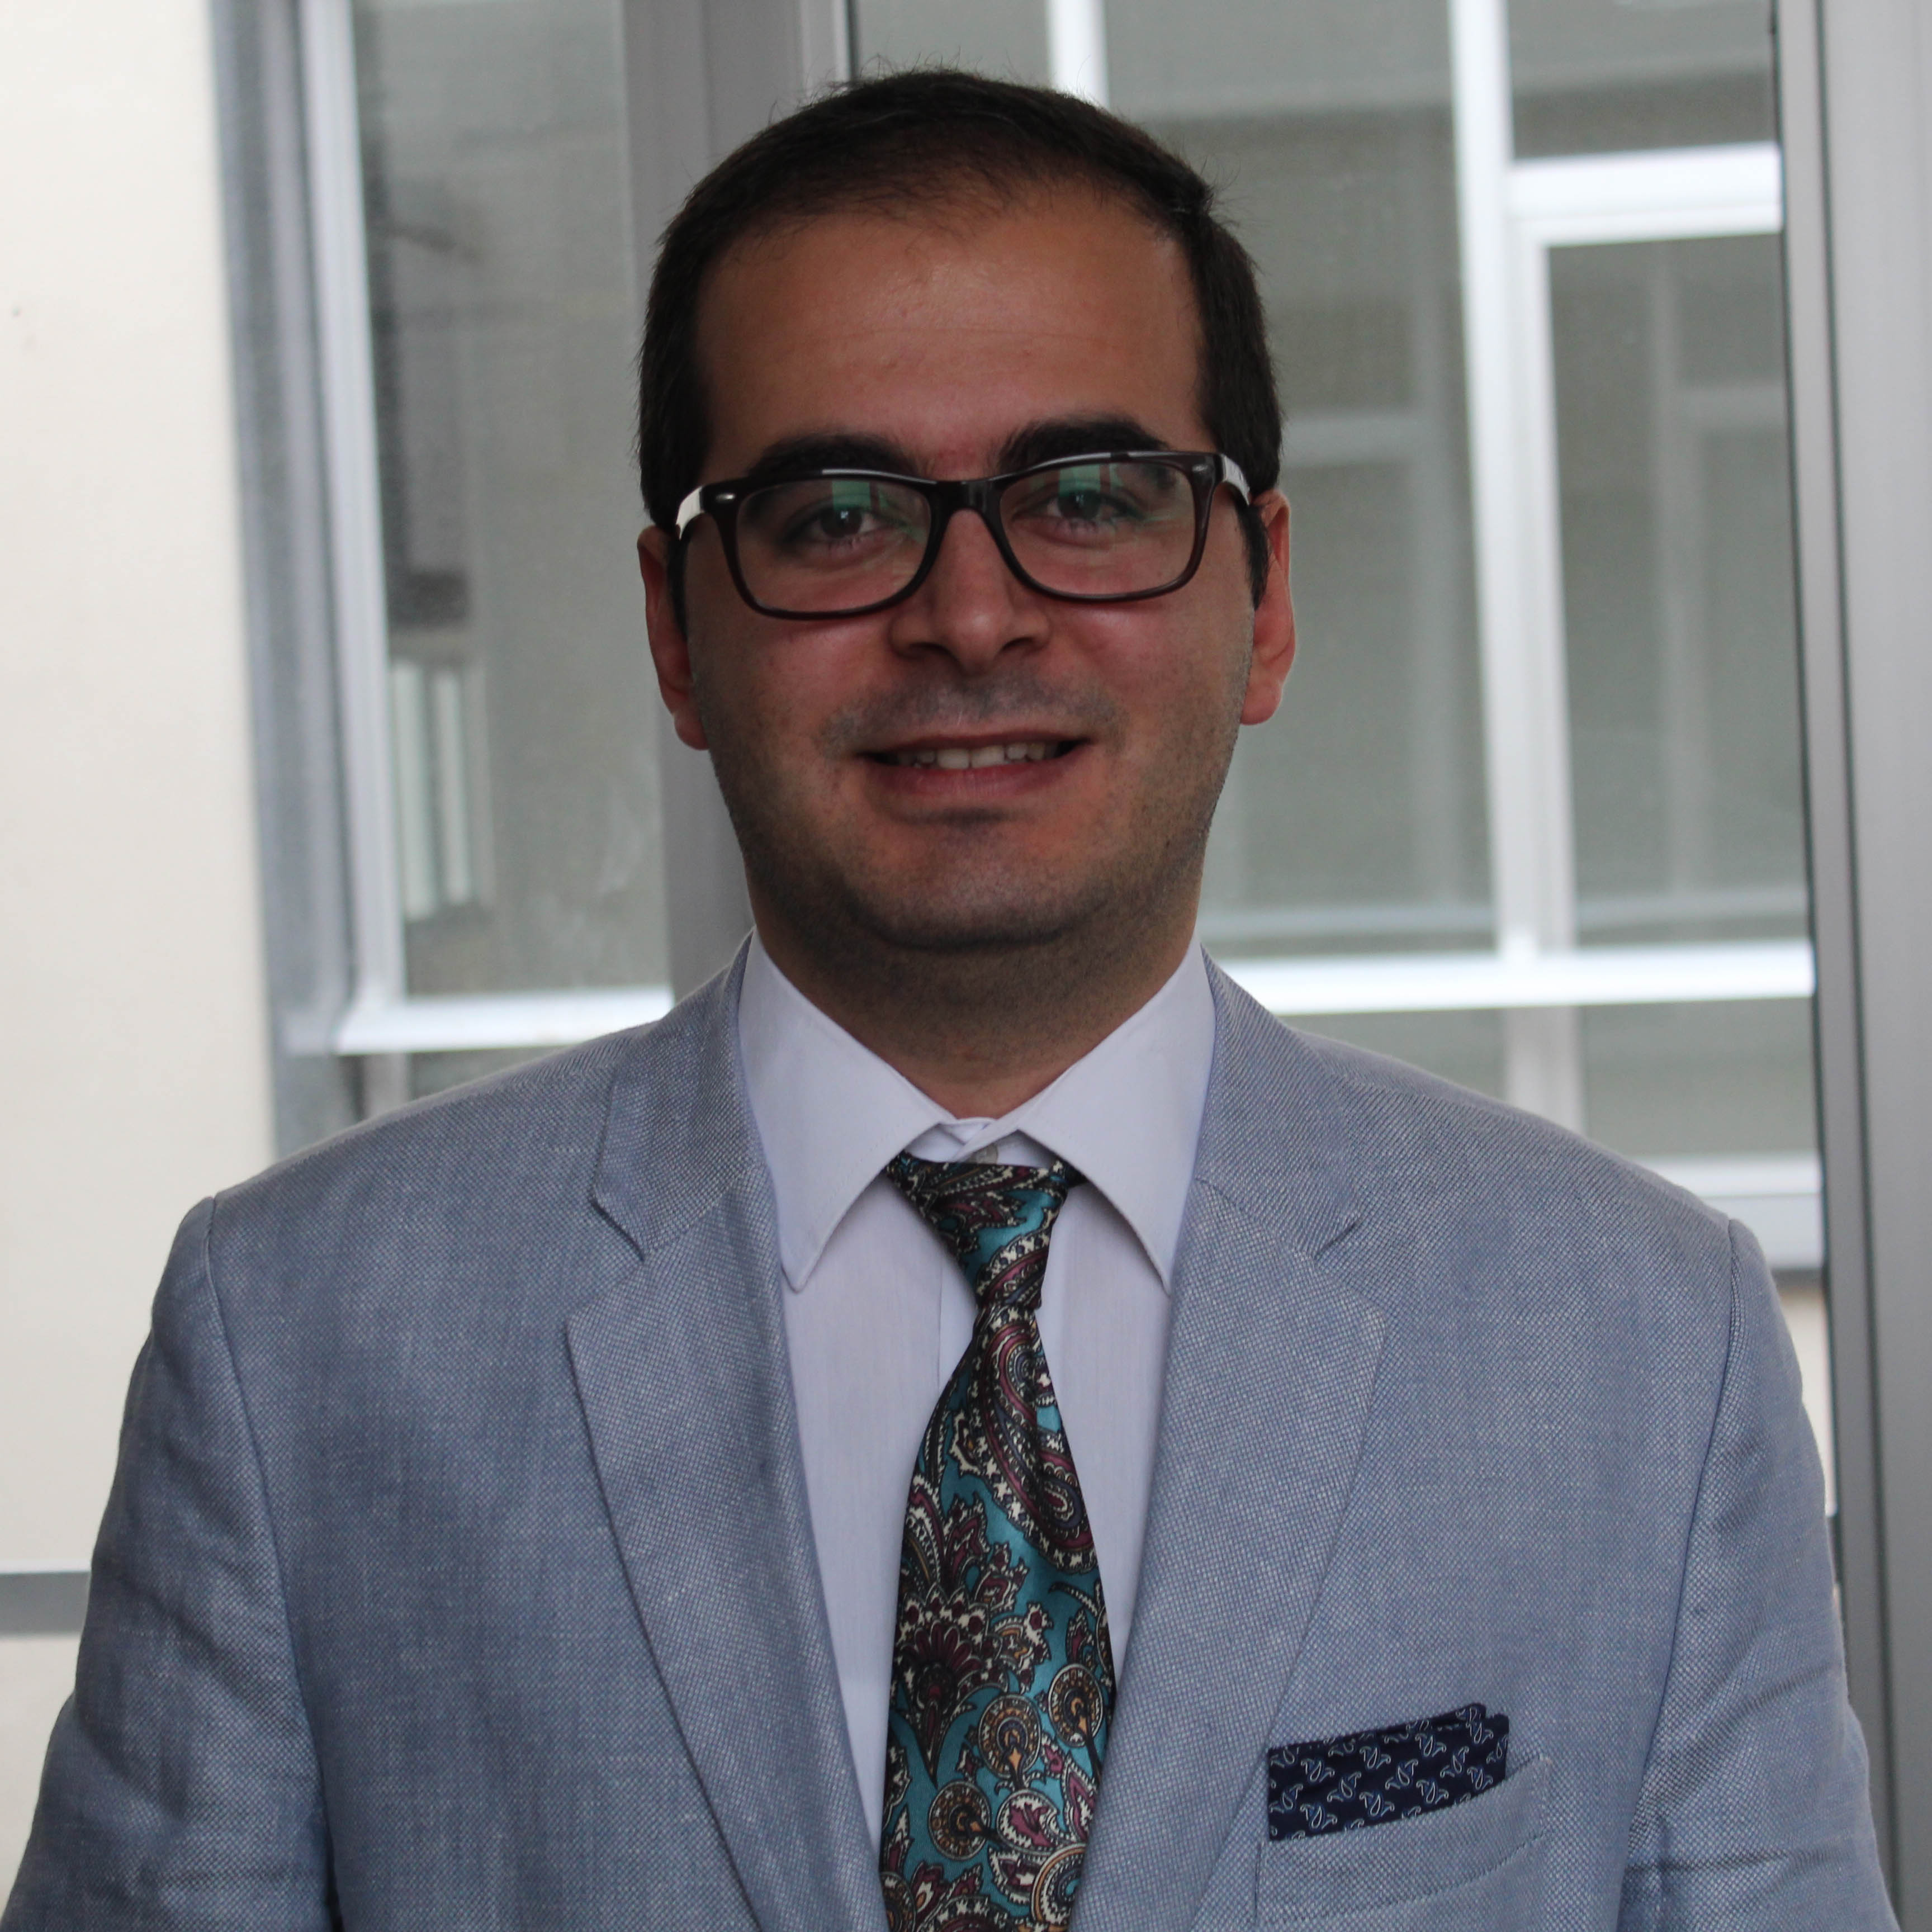
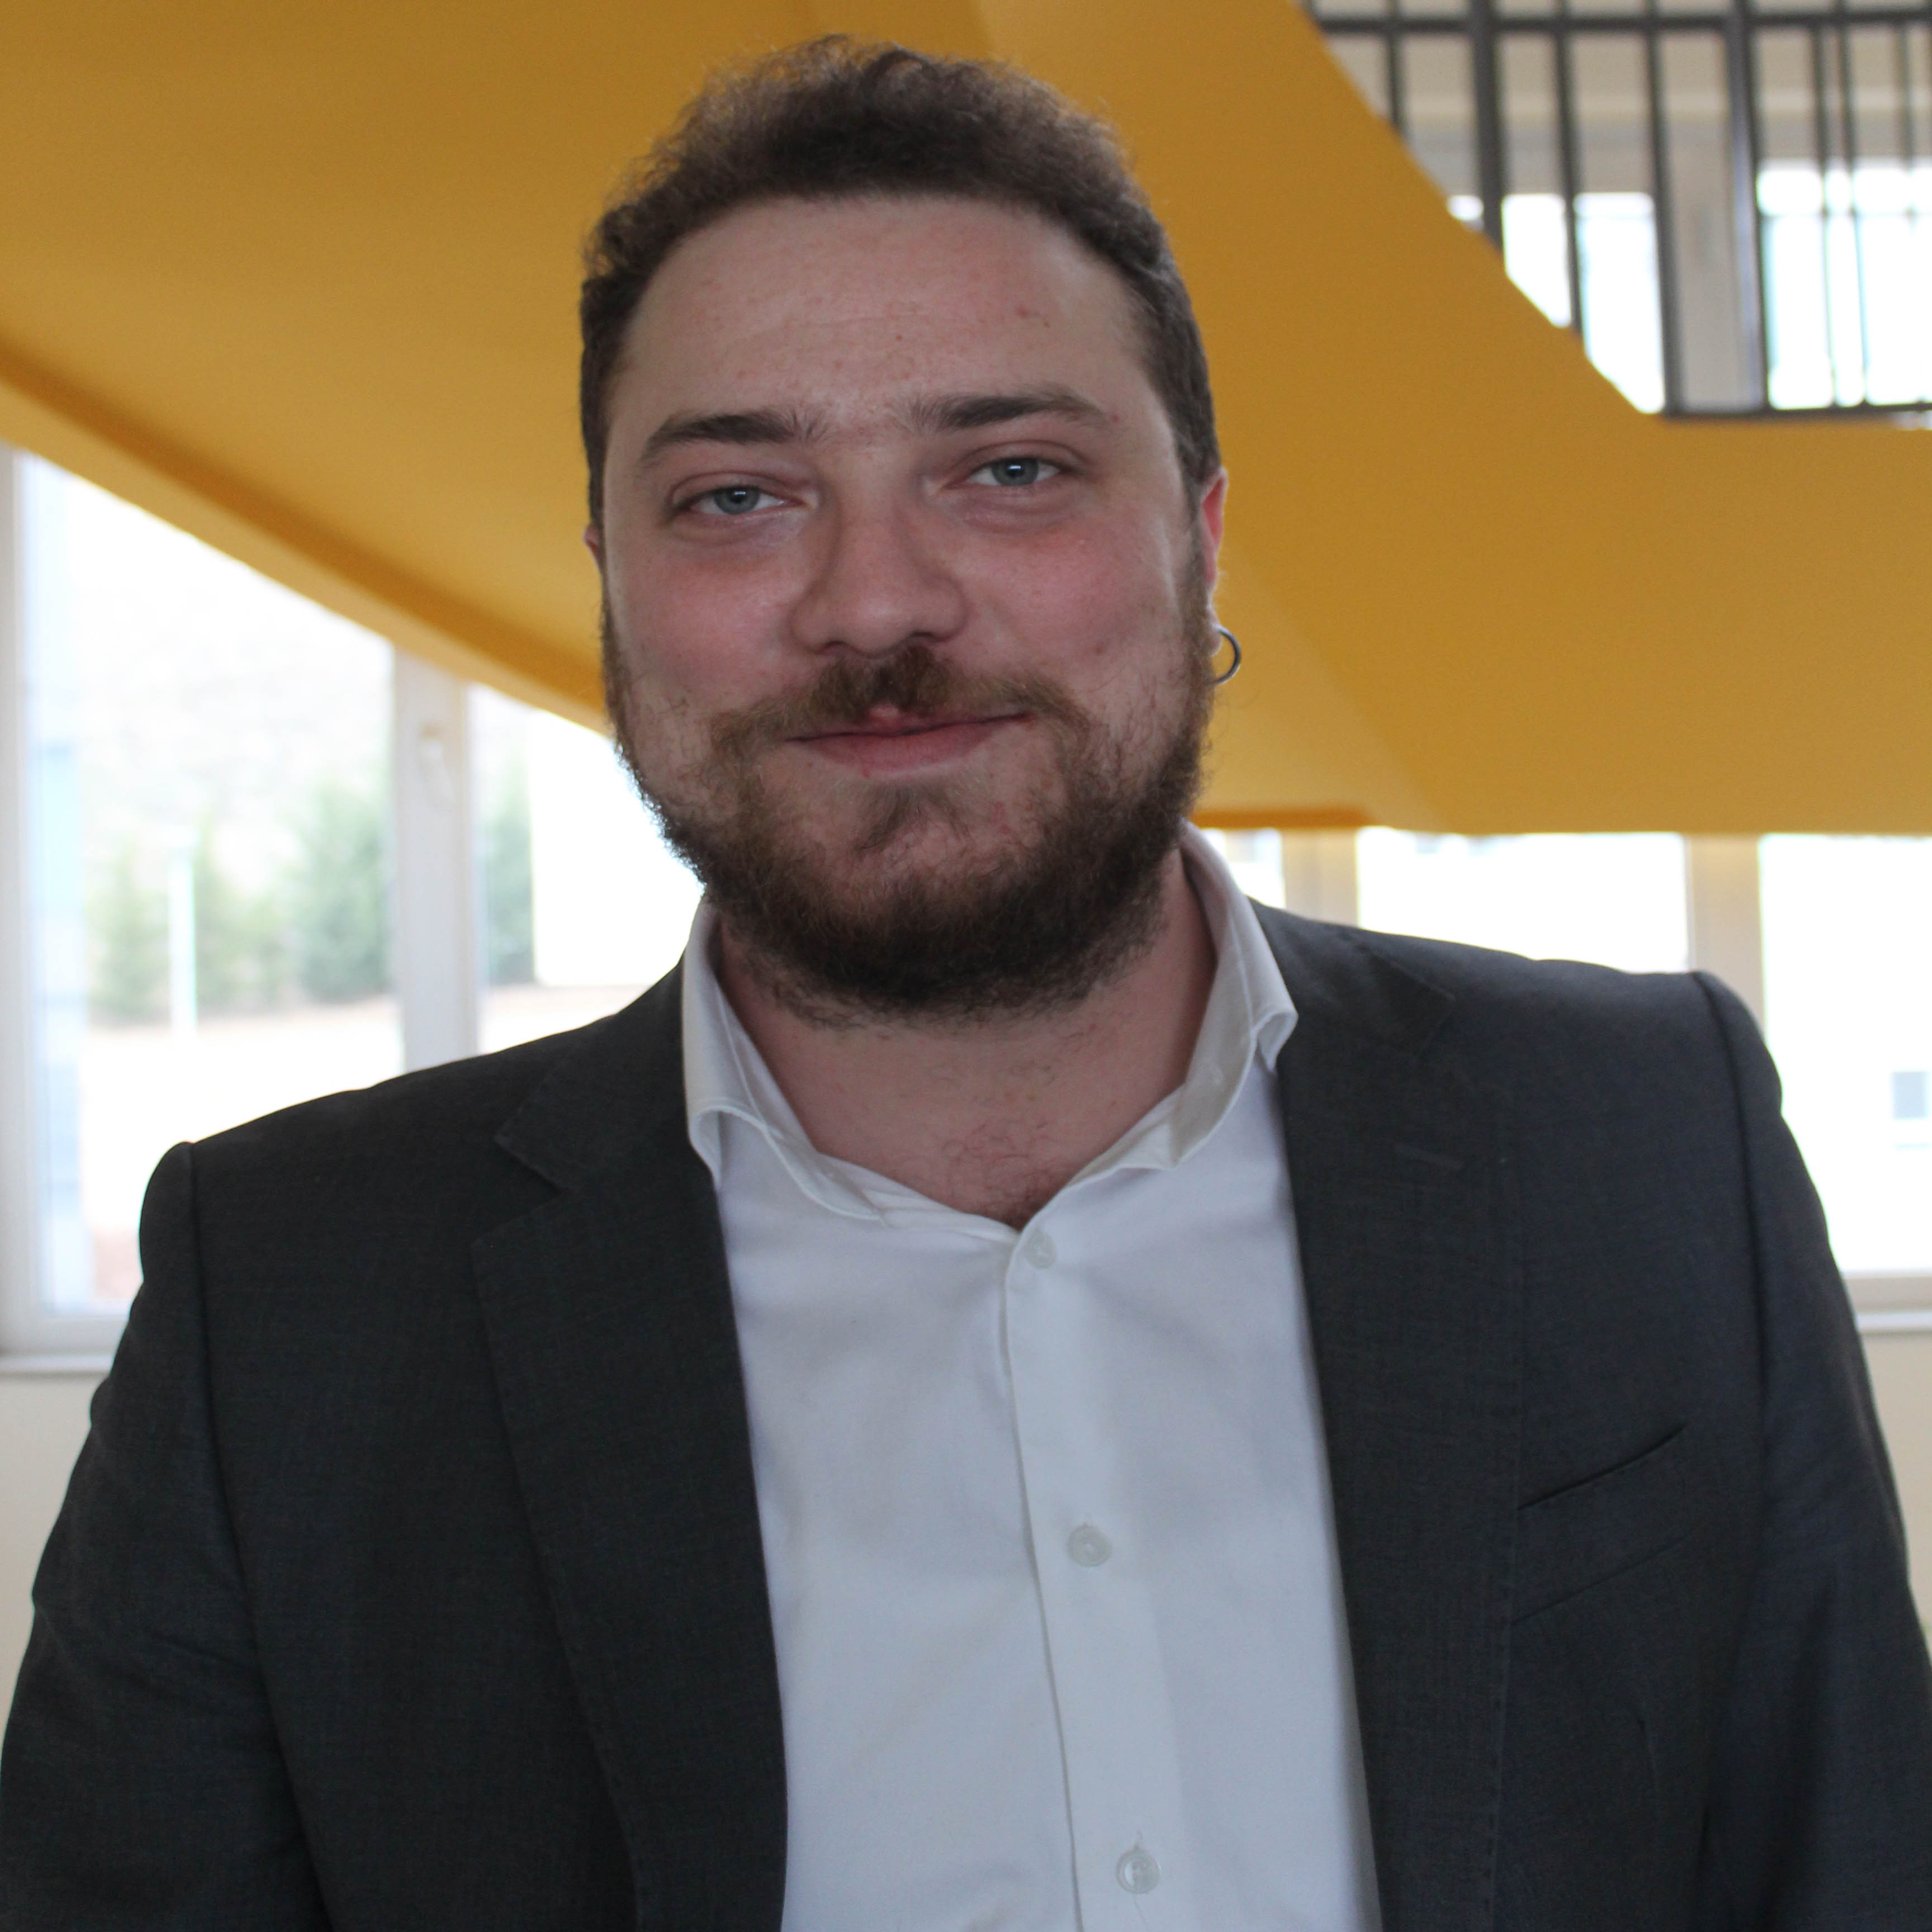
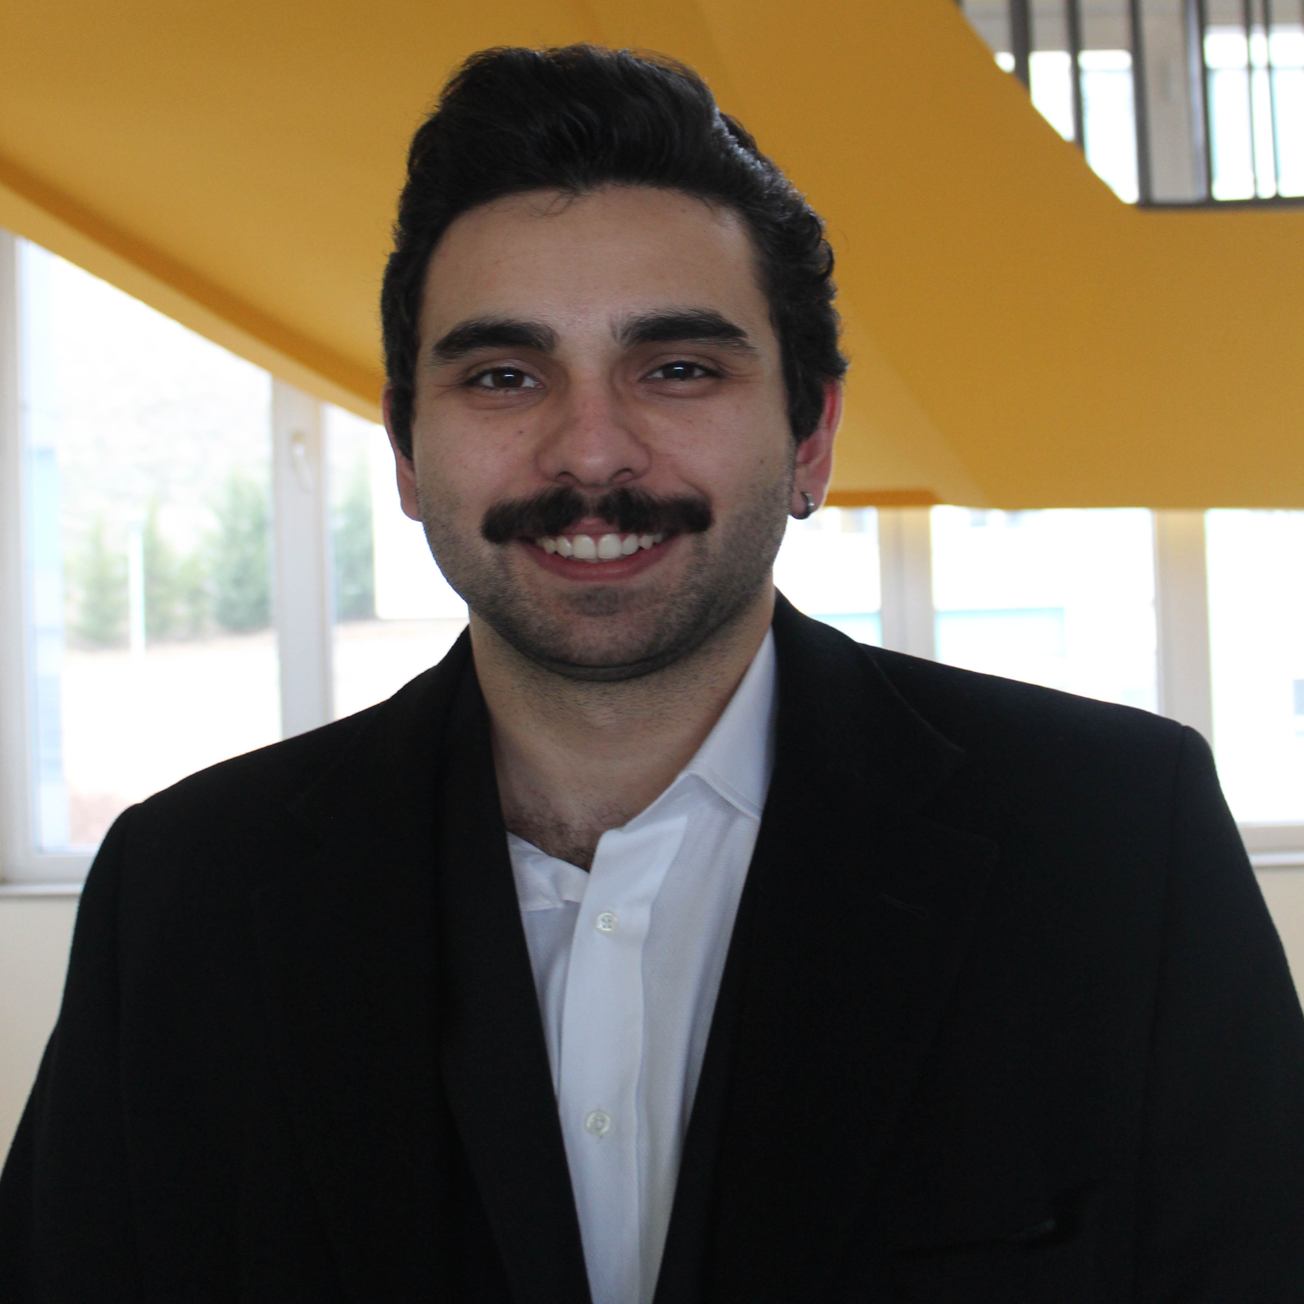

REZES
Recycling IoT Application Systems
Team Members
Sezer UĞUZ
Computer Engineering Department
Burhan ÜNALP
Computer Engineering Department
Çağlar KOÇAK
Computer Engineering Department
Rahan ESKİ
Computer Engineering Department
Advisor: Assist. Prof. Dr. Gül TOKDEMİR

Slide 3
Contents
REZES Recycling IoT Application Systems
Problem
Solution
Results and Conclusion
References
Demo

Slide 4
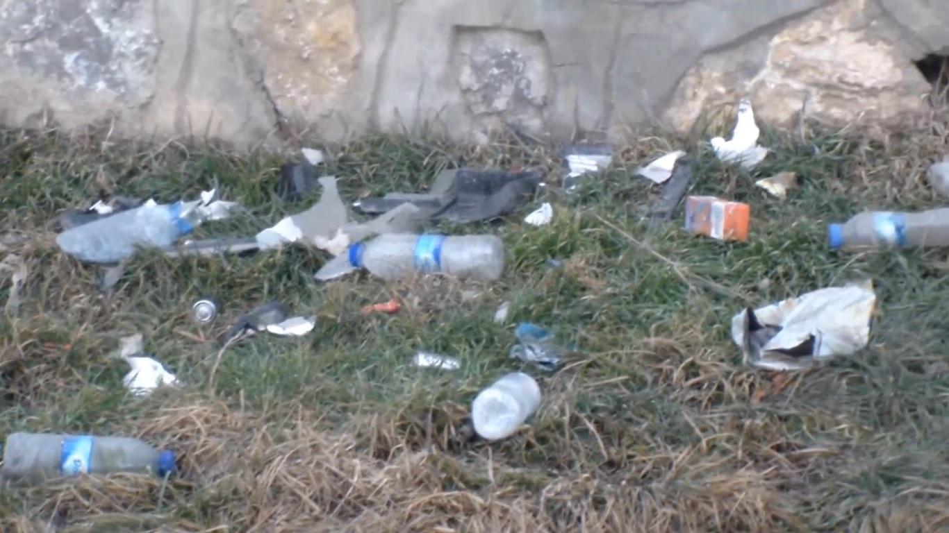
Problem
REZES Recycling IoT Application Systems
Garbage has become a serious problem in the world today and this situation continues to increase rapidly day by day.
Plastic bottles, metal bottles, glass bottles are wasted by being thrown into the environment which causes;
Soil Pollution,
Water Pollution and
Air Pollution.

Slide 5
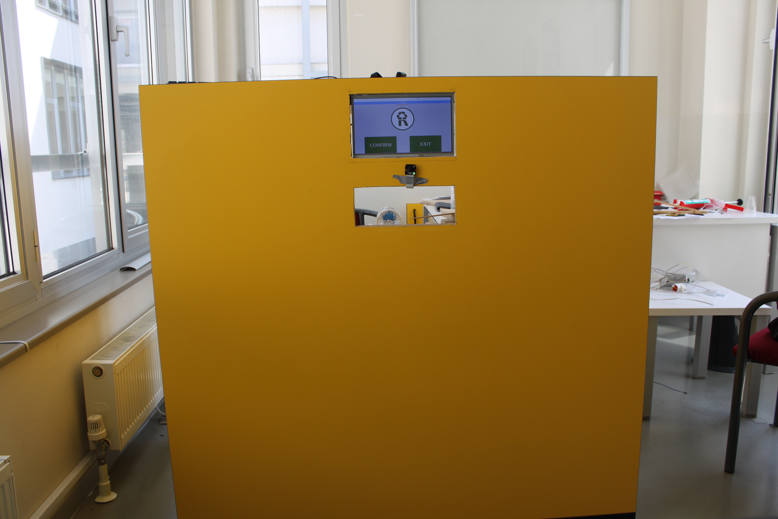
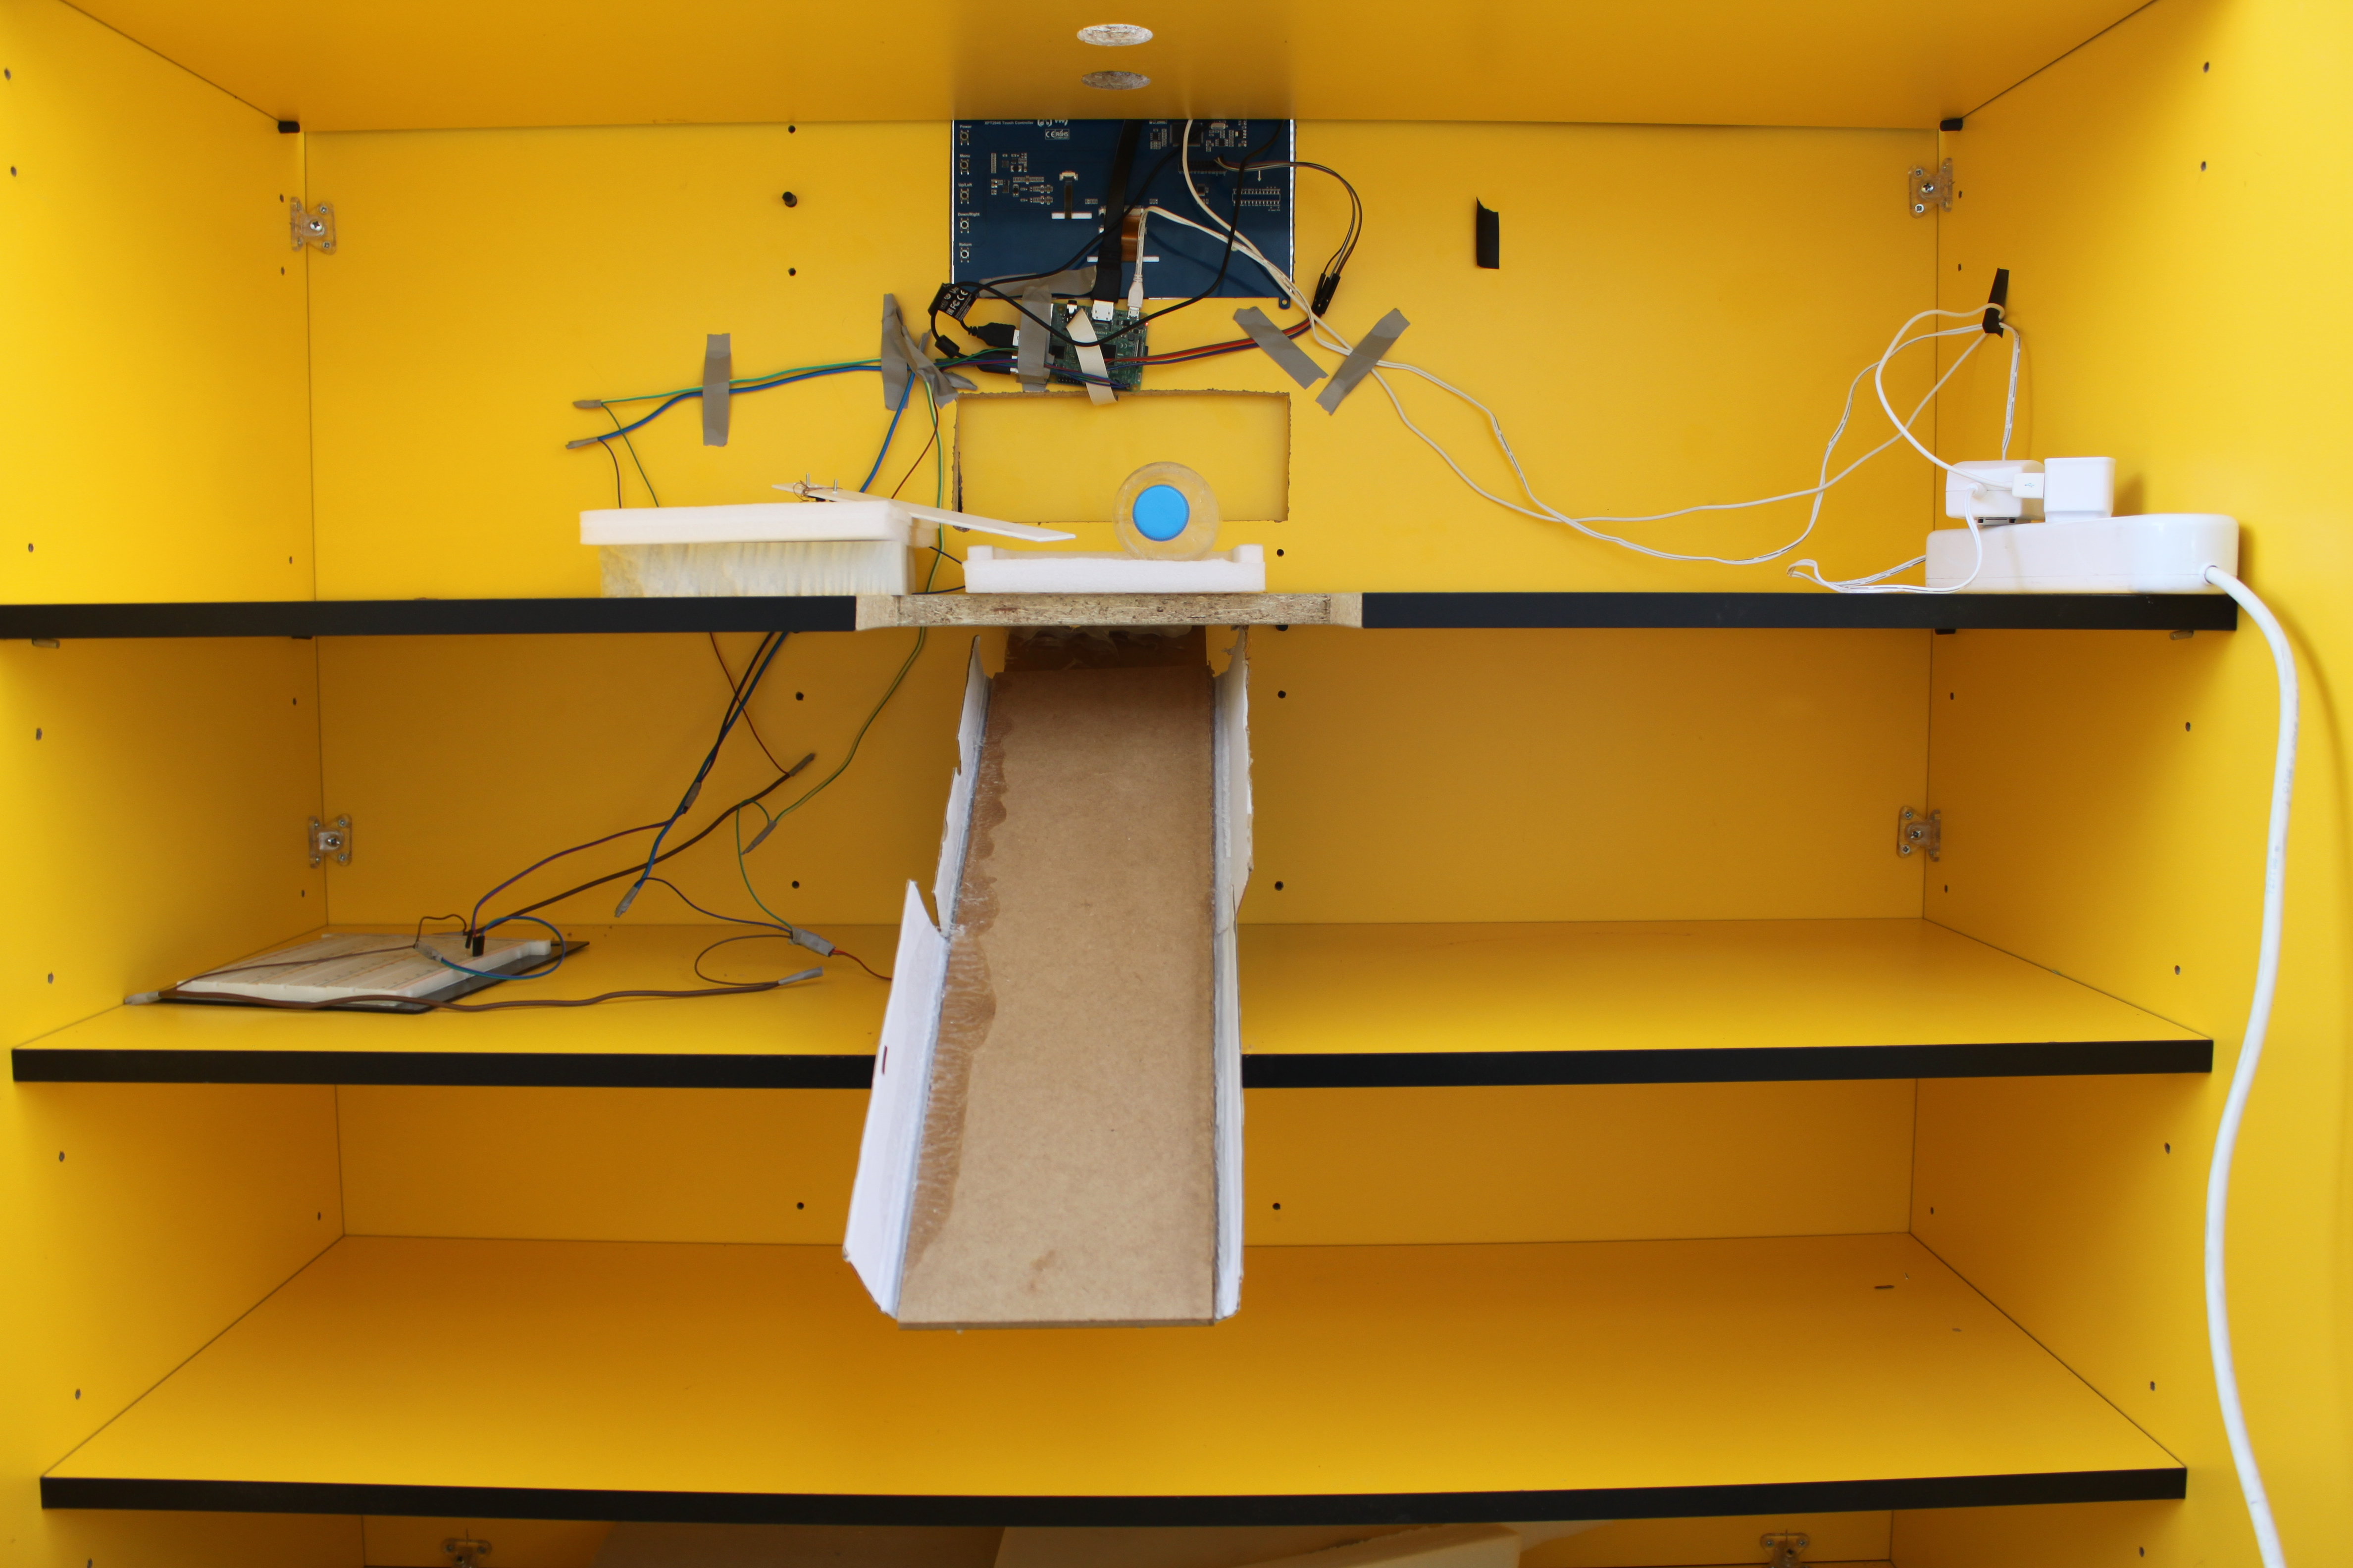
Our Solution REZES Smart Recycling Machine
REZES Recycling IoT Application Systems

Slide 6
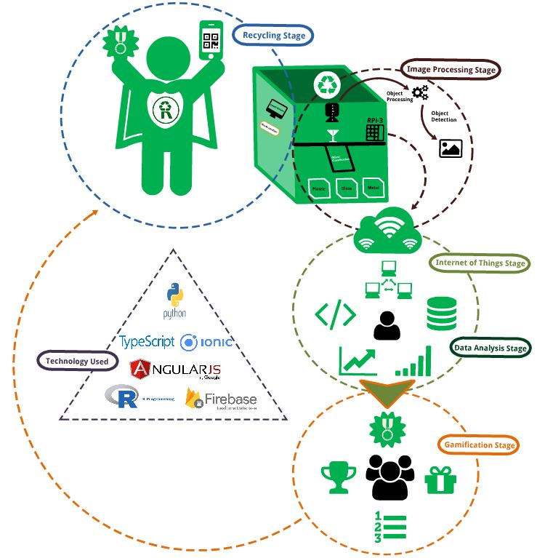
REZES Recycling IoT Application Systems

Slide 7
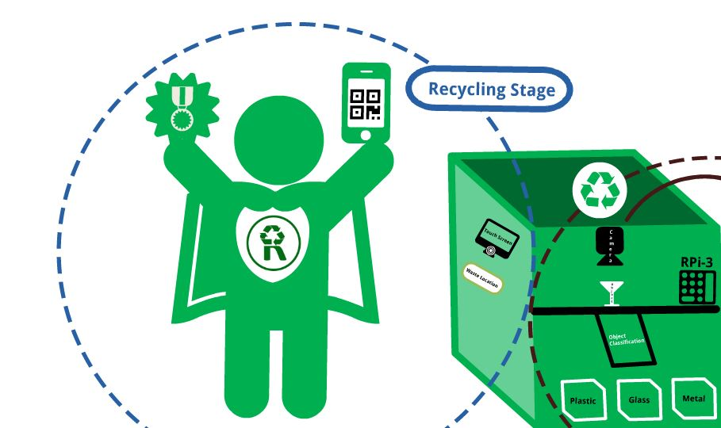
REZES Recycling IoT Application Systems

Slide 8
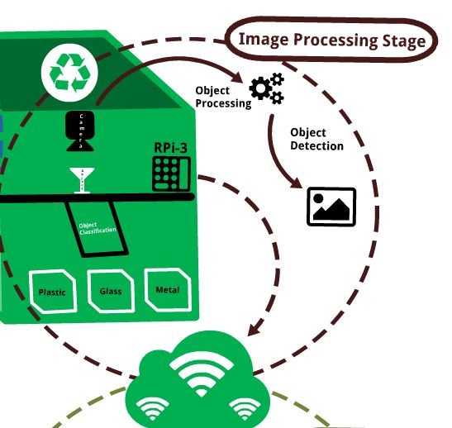
REZES Recycling IoT Application Systems

Slide 9
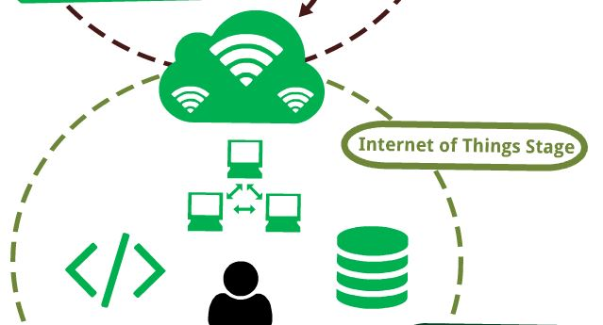
REZES Recycling IoT Application Systems

Slide 10
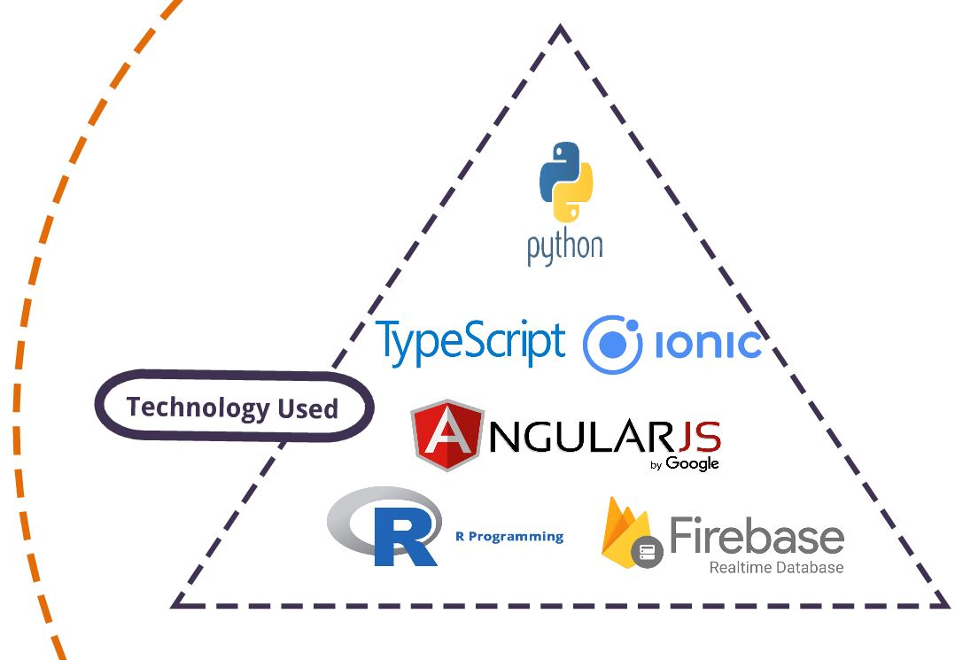
REZES Recycling IoT Application Systems

Slide 11
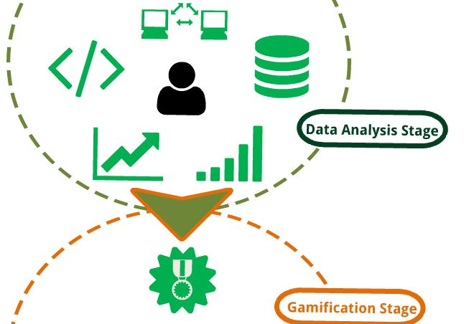
REZES Recycling IoT Application Systems

Slide 12
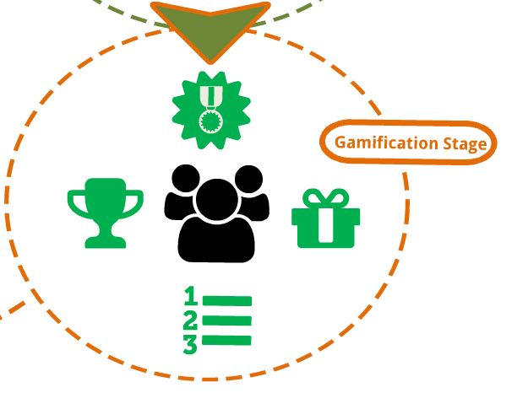
REZES Recycling IoT Application Systems

Slide 13
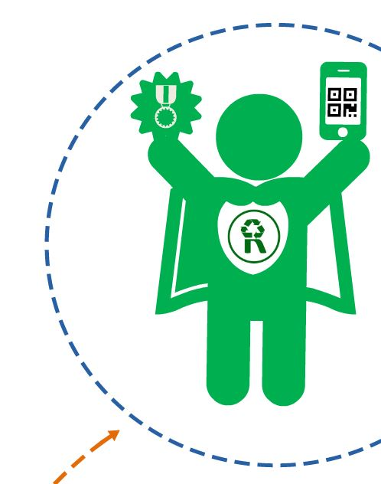
REZES Recycling IoT Application Systems

Slide 14

REZES Recycling IoT Application Systems
We tried C# for raspbian.
C# is not raspbian-supported.
Java and Python.
Python is performanced.

Slide 15
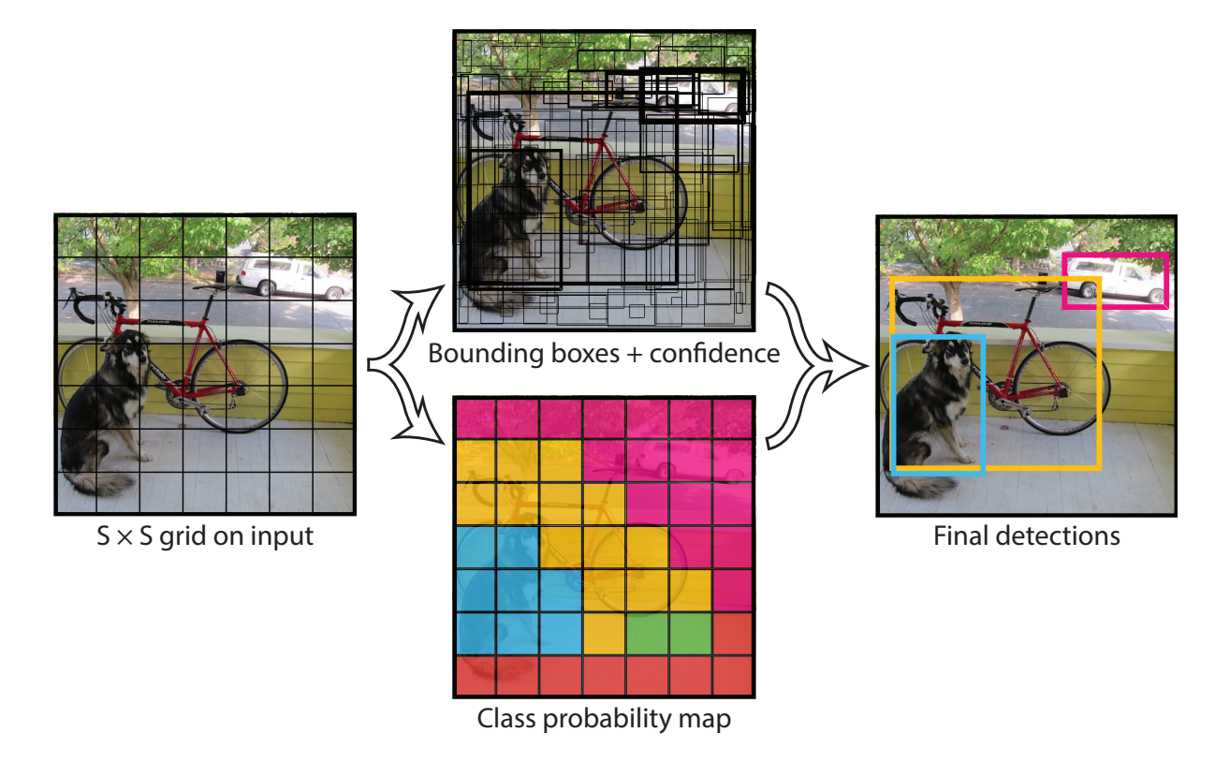
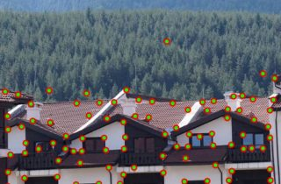
REZES Recycling IoT Application Systems
Two different options:
YOLO Detection
OpenGL Detection

Slide 16
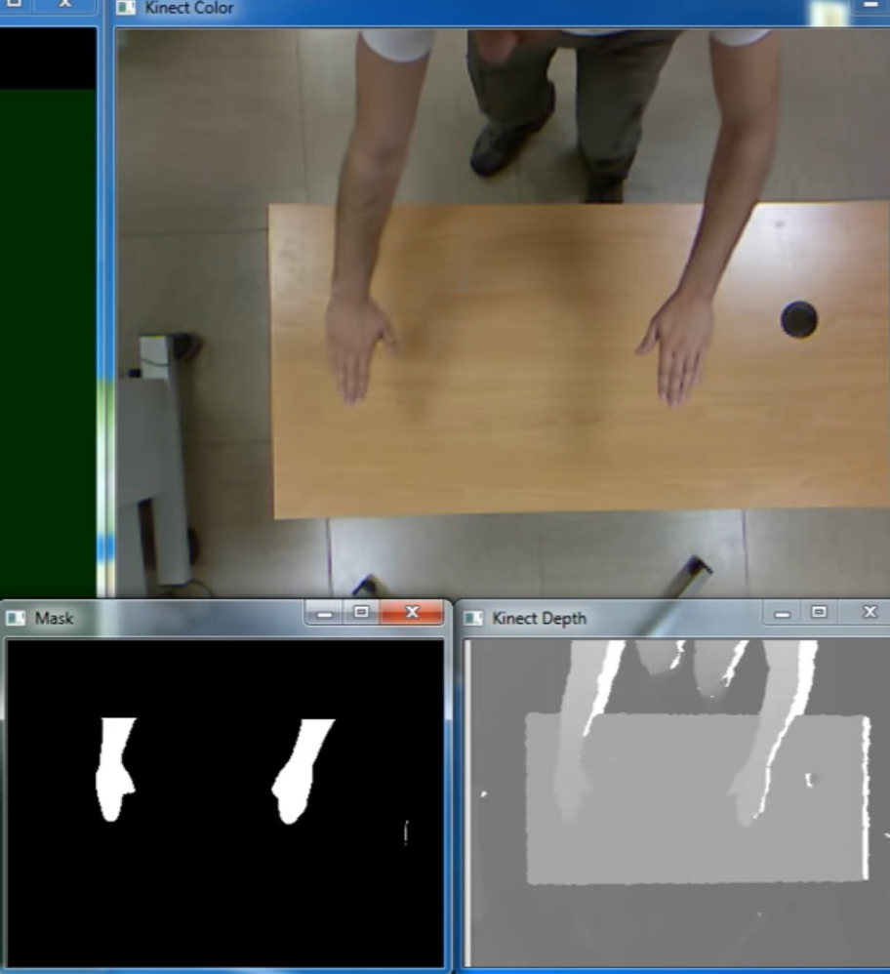
REZES Recycling IoT Application Systems
Determine the corner points
Connected with each other
Converts to xml format

Slide 17
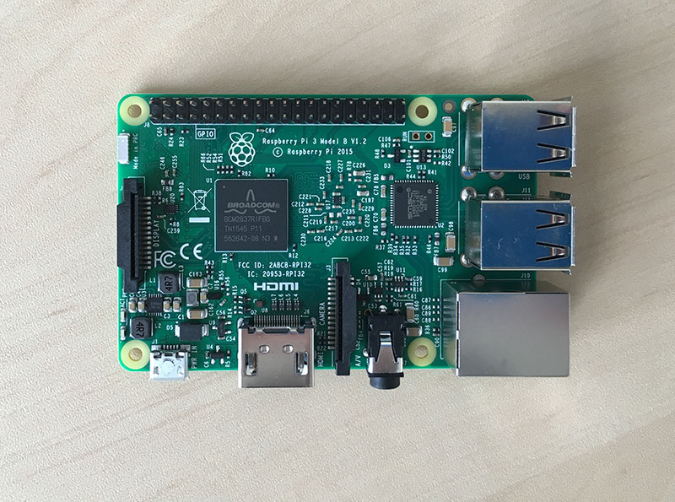
REZES Recycling IoT Application Systems
Raspberry Pi 3+ (Model B+)
10.1’’ Touch Screen for Raspberry Pi
Module camera
Stock camera

Slide 18
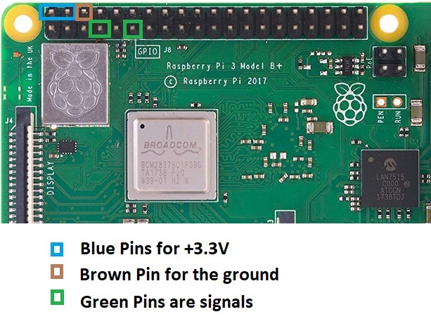
REZES Recycling IoT Application Systems
Used for servo motors
Valued by 7 and other signal pin is 11.

Slide 19
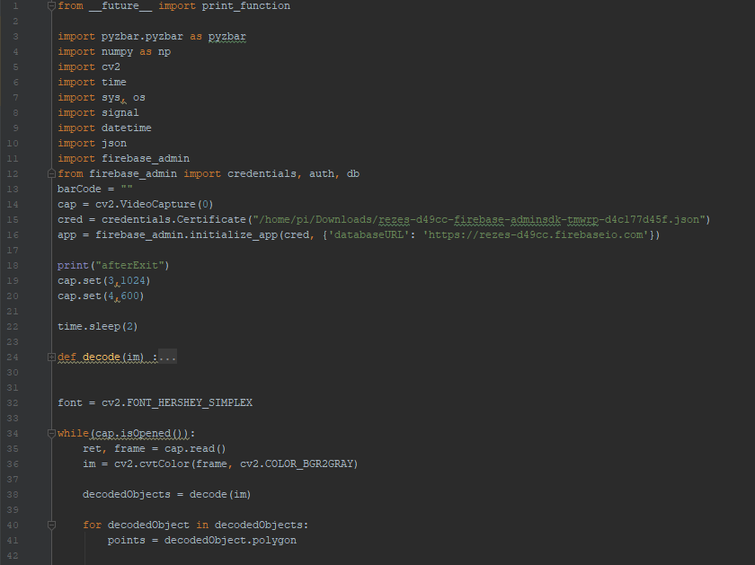
REZES Recycling IoT Application Systems
Main Page for detection QR-Code
VideoCapture for 2 different camera
FireBase Connection
Screen Size set

Slide 20
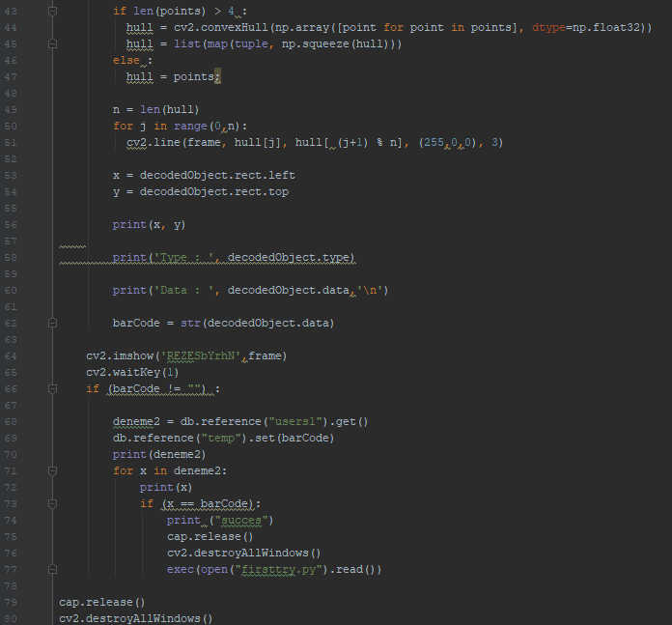
REZES Recycling IoT Application Systems
Checking all data from Fire Base with QR-Code
When match;
Stock camera and windows destroyed
Then Exec function is used.

Slide 21
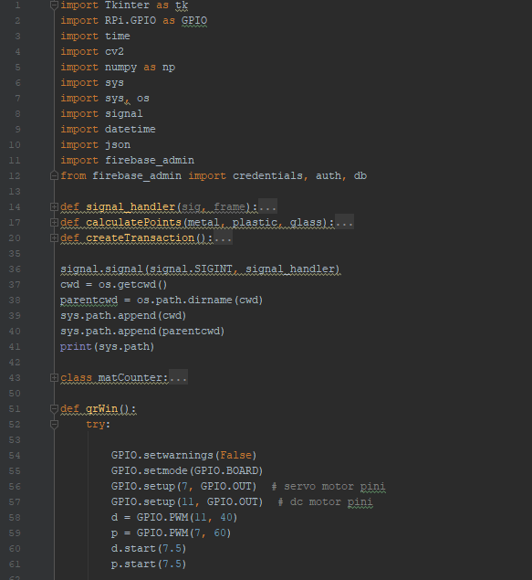
REZES Recycling IoT Application Systems
Some functions for calculating
GPIO is used for pins on Raspberry Pi
Installation of two different servo motors
And their positions at the start

Slide 22
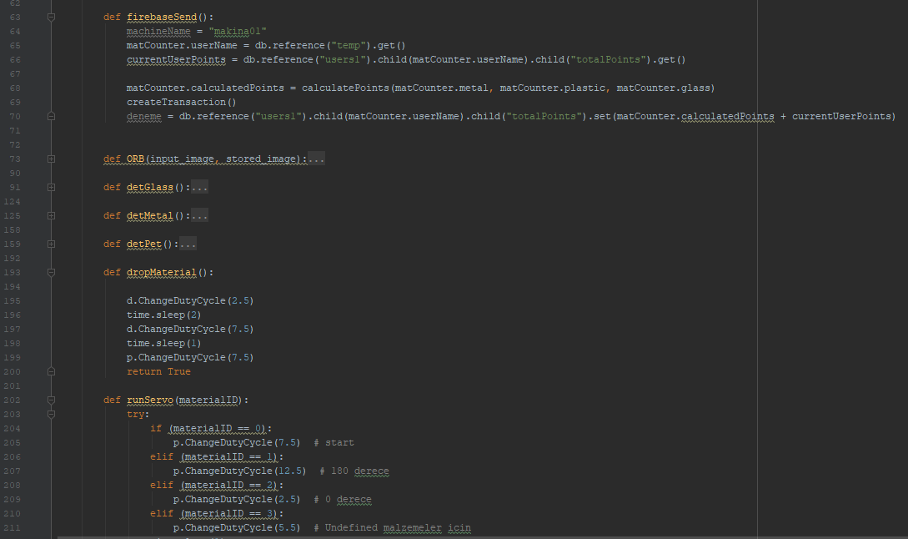
REZES Recycling IoT Application Systems
FireBase send function
When detection end
dropMaterial() is used for pushing servo motor movement
And runServo() is used for to separate according to the type of materials

Slide 23
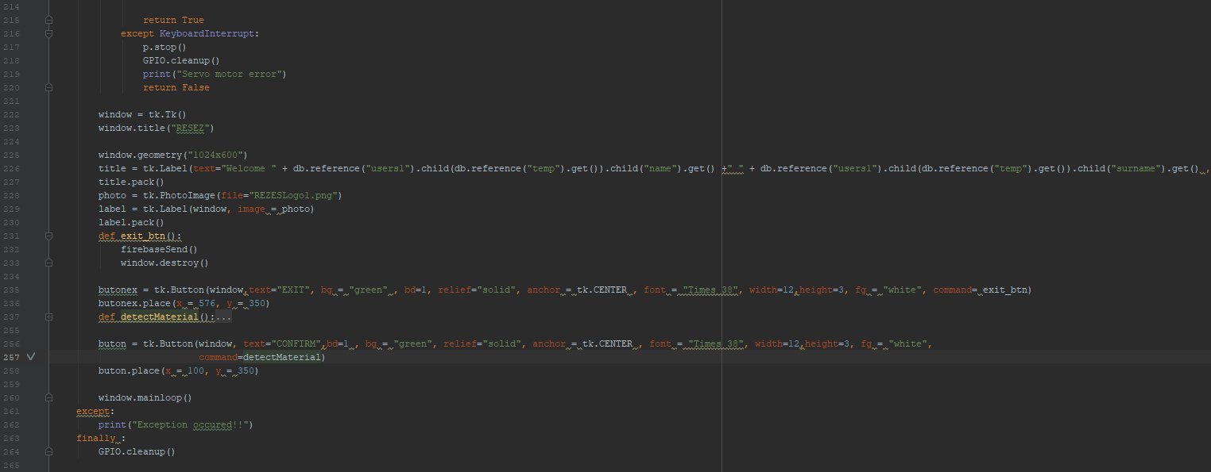
REZES Recycling IoT Application Systems
Tk methods are used for GUI and CONFIRM button is starts all detection

Slide 24
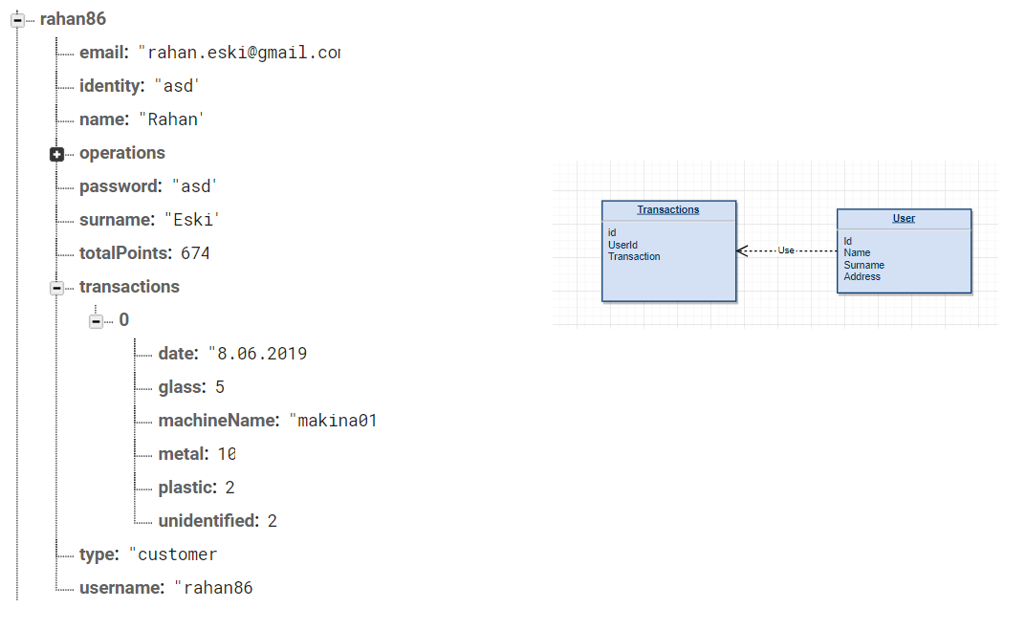
REZES Recycling IoT Application Systems
No SQL SQL

Slide 25
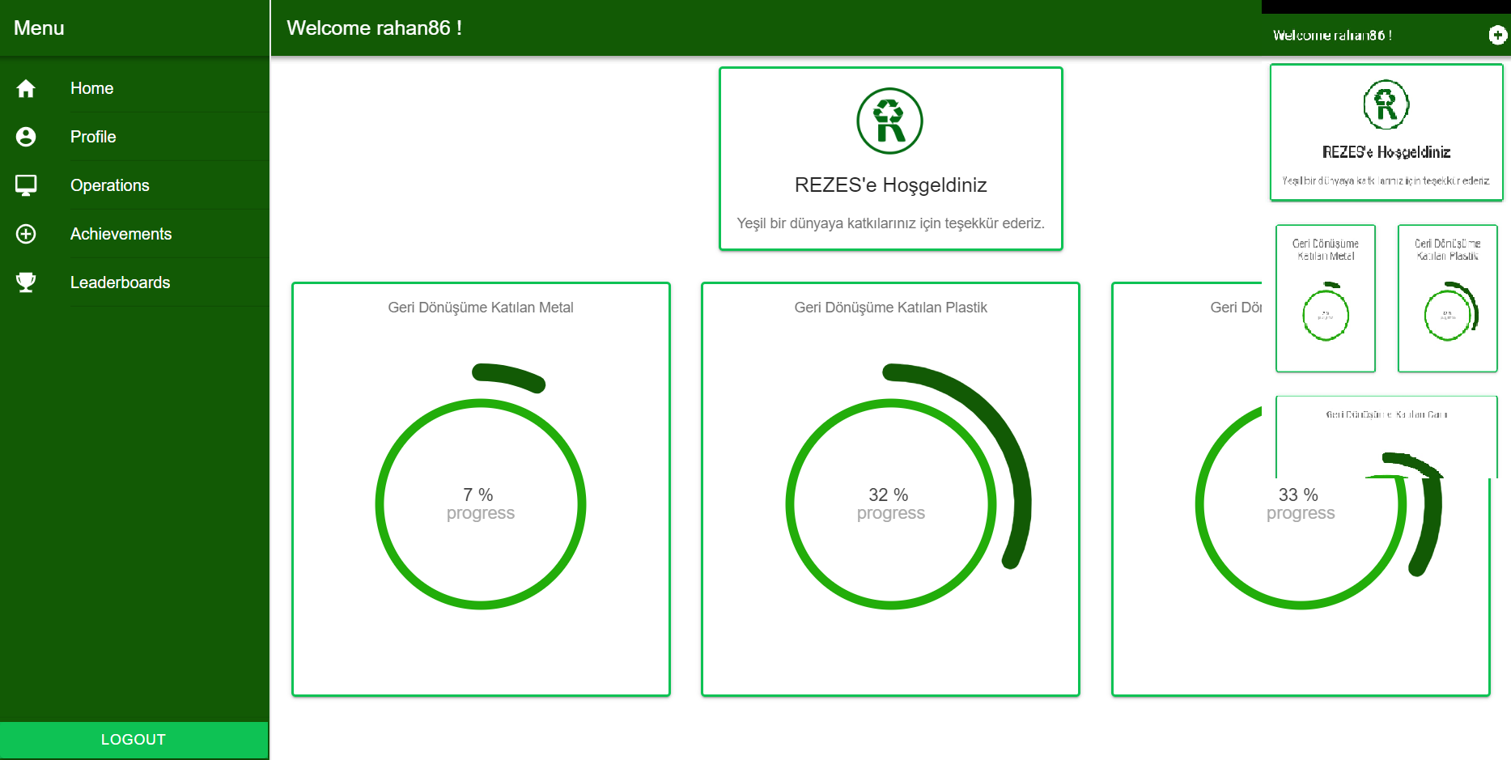
REZES Recycling IoT Application Systems

Slide 26
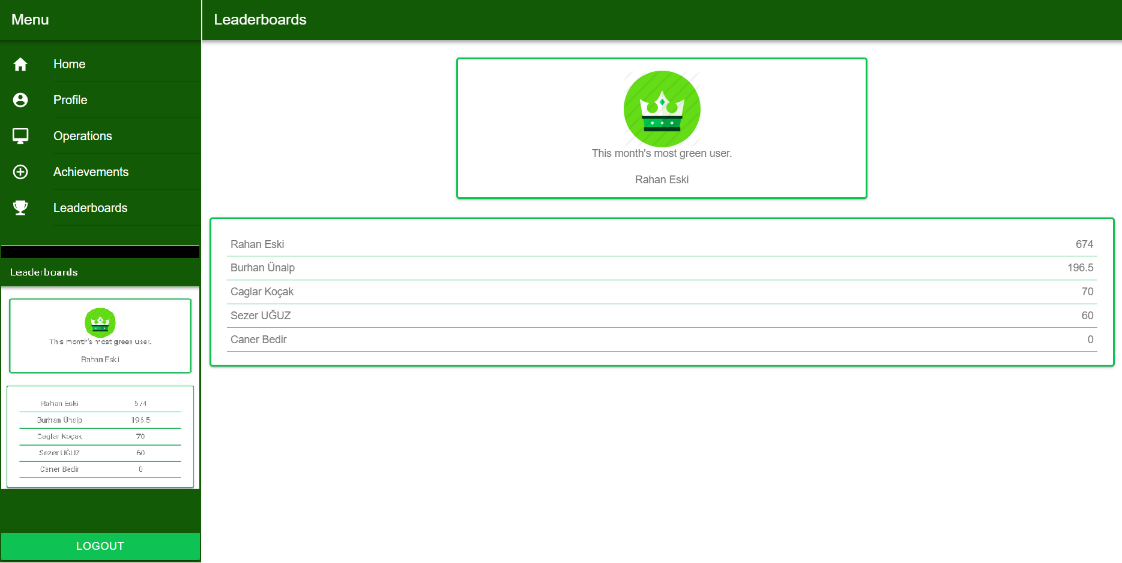
REZES Recycling IoT Application Systems

Slide 27

Results and Conclusion (Demo Video)
REZES Recycling IoT Application Systems

Slide 28
THANK YOU FOR YOUR PATIENCE QUESTION?
REZES Recycling IoT Application Systems

